Slide 1
Virustotal Spelunking
Monty St John
Chris Rogers

Slide 2

Monty St John
Military
Navy Search & Rescue
POW/MIA Researcher
Coder/Software Engineer
Cybercrime/DC3
Jow Ga Sifu
Threat Intelligence Revolutionary
Monty St John
ATXForensics
Email: monty@atxforensics.com

Slide 3

Chris Rogers
Army Intel Sigint / Humint
Government Contractor
DOD/DOS/USCERT
DC3 Forensic Examiner / Intrusions
Bank of America
Fidelis
FusionX
Chris Rogers
Senior Something or Other
FusionX, an Accenture company
Email: myname@fusionx.com

Slide 4
Objective:
Show you how to get useful intelligence from virustotal
Notes:
Over the next 40 minutes we will try to drown you with information you can use to find your way through VT all while gathering intelligence for profit.

Slide 5
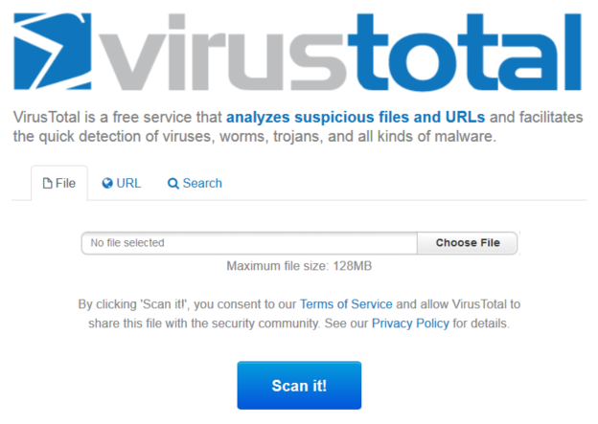
Free service that analyzes suspicious files and URLs
Accepts input via browser, email or upload from script or utilities

Slide 6
Not a virus scanner
Aggregates verdicts made by virus and website scanners
Not a correlation engine
Provides the detection label of scanning solutions
Not a classifier
Collects and organizes the output of file and URL characterization tools

Slide 7
Virustotal spelunking lets you:
Pattern search for data
Discover updated files of interest
Explore the DNS collected by Virustotal
Explore the data exposed by Virustotal users
Who is submitting files?
Where are they coming from?
Comments and correlating data

Slide 8
Search capabilities:
@profile
#tag (comments)
IP
Domain
File Hash (not section, PE, Authenticode, etc.)

Slide 9
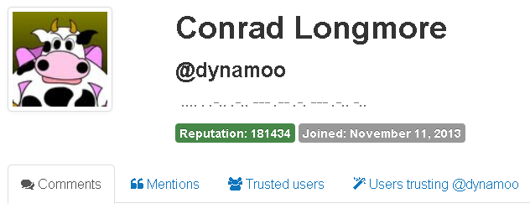
Profiles (@name)
Comments
Mentions
Trusted Users
Users Trusting
Notes:
You research to explore their connections. People with no activity in these tabs == one timers but that’s insufficient for accuracy. Numerous people also don’t trust, get trusted, make comments or get mentioned that are very active.

Slide 10
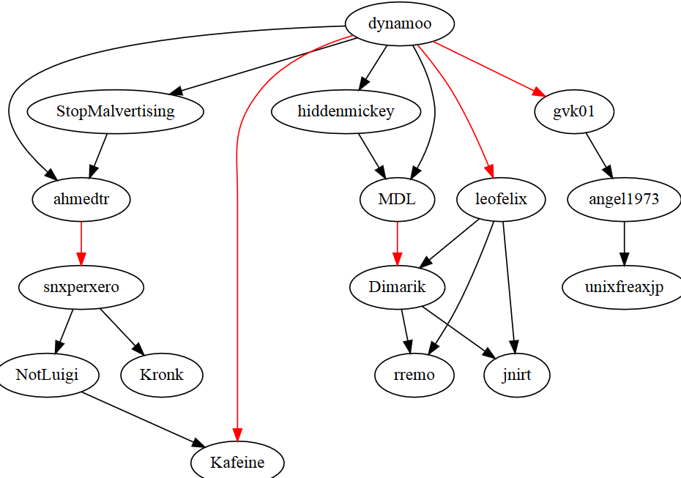
Why would I care?
explo(re|it) their connections
Reputation a soft indicator of trust
Additional data in comments
Notes:
You research to explore their connections. People with no activity in these tabs == one timers but that’s insufficient for accuracy. Numerous people also don’t trust, get trusted, make comments or get mentioned that are very active. Data in comments can lead to hints and leads to connections to files, people, and events
Each time you are trusted, you gain 10% of the truster’s reputation
+3 rep for each comment voted on as useful
malicious vs benign voting as adds to score (formula)

Slide 11
Tags (or comments if you prefer)
#tag name; found in comments
Can provide context to the file
Point to other analysis

Slide 12
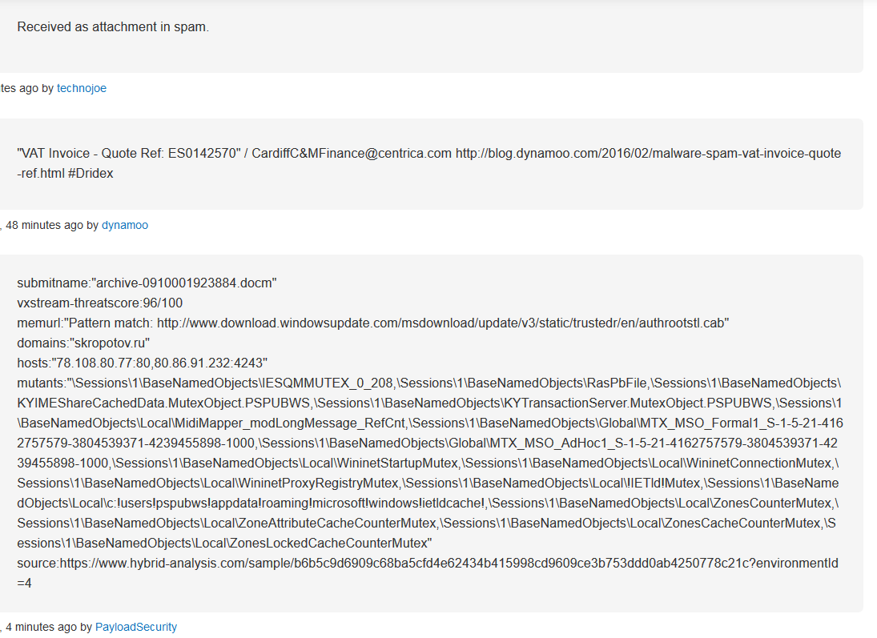
Context
Pivots for additional analysis

Slide 13
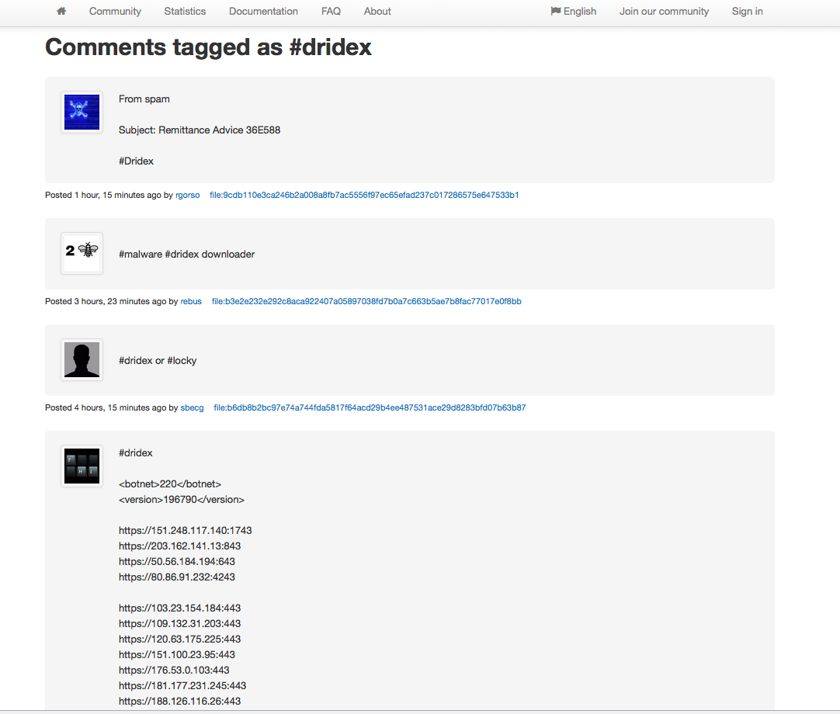
Subject
Pivots for samples (Indicators)
Analysis Comments
Notes:
A quick Google search can give you insight to recent samples. Automation can be applied with website monitors or even basic crawl scripts which can help proactively protect or help flesh out response tactics within a few clicks.

Slide 14
IP Address
Easy, but useful
Passive DNS
Latest detected URLs (useful)
Latest detected files (AV+VT downloaded)
Latest undetected files (zero AV + VT downloaded)
Notes:
pDNS = domains == IP,

Slide 15
Grab the domains and dates for an IP
Perform the domain mining you would normally do
pDNS
TLD Analysis
Domain Text Mining
Notes:
pDNS = domains == IP,

Slide 16
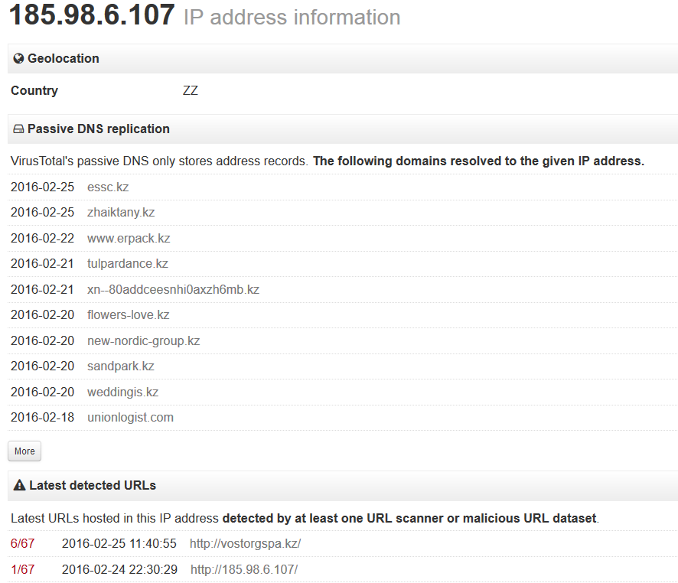
==registrar | 8
==email | 10
~=WHOIS | 17
~=content | 14
domain chunks | High Count
xn-- | 5
city | 3
group | 3
log | 3
union | 3
%TLD | %
kz | 99
other | 1
Notes:
pDNS = domains == IP,

Slide 17
Last detected URLS
Analyze for web structure
Implant pages
Parameters
Notes:
pDNS = domains == IP,

Slide 18
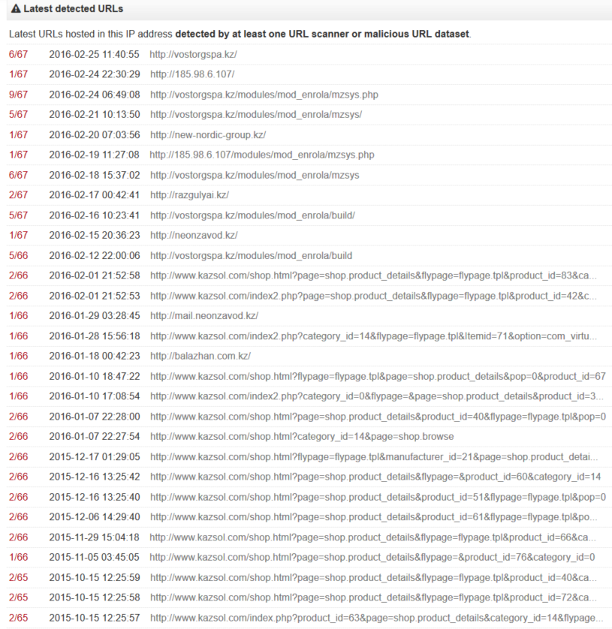
Parameters | Value
?page= | website page
&flypage= | flypage.tpl
&product_id= | #-###
&category_id= | 3
&pop= | 0 or 1
&option= | com_virutalmart
&manufacturer_id= | #-###
&item_id= | #-###
Notes:
pDNS = domains == IP,

Slide 19
Structure
modules/
mod_enrola/
mzsys/
build/
Implant
mysys.php
index.php
...more
Notes:
pDNS = domains == IP,

Slide 20
Domain
like IP Address
Passive DNS
Latest detected URLs (useful)
Latest detected files (AV+VT downloaded)
Latest undetected files (zero AV + VT downloaded)
Notes:
pDNS = domains == IP,

Slide 21
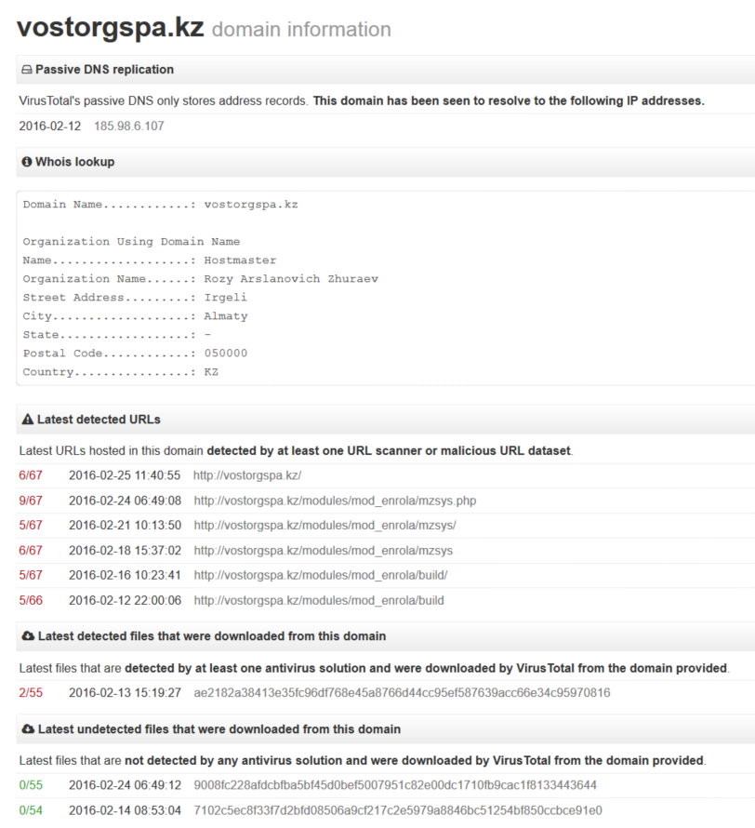
IP Address connections
WHOIS data
Structure
modules/
mod_enrola/
mzsys/
build/
Notes:
pDNS = domains == IP,

Slide 22
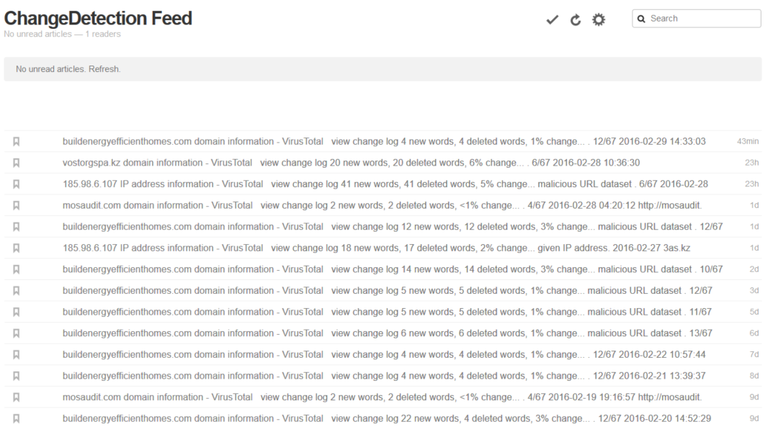
Of course, it goes without saying that you should monitor the VT pages of interest
Notes:
The above illustrates as usage of changedetection.com and feedly.com to monitor VT domains and IP addresses for changes.

Slide 23
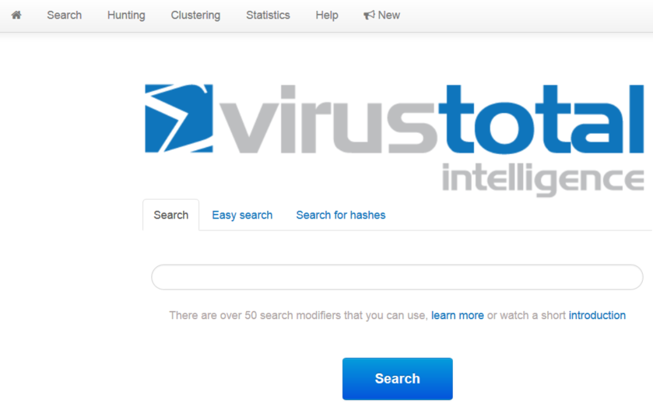
Let’s go deeper with VT’s private key
Get access to current and historical data
Can hunt VT with yara for “as it happens” actions but you can also spelunk the data for historical info
Don’t go in blind -- use a strategy to find what you want

Slide 24
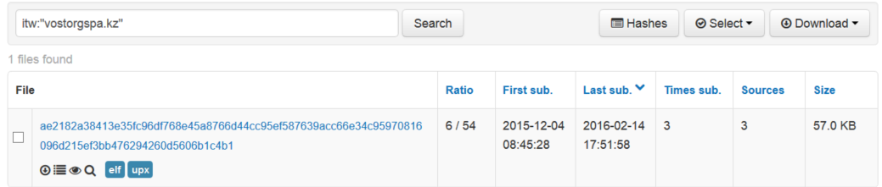
itw:”vostorgspa.kz”
returns files downloaded from the URL
Can refer specifically to a download link or chain them:
itw:"unionlogist.com" or itw:”185.98.6.107” or itw:”vostorgspa.kz/modules/mod_enrola/build”
Notes:
Let’s stay on theme to the previous IP/Domain combination and get any files downloaded: ITW: urls from sample behavior

Slide 25
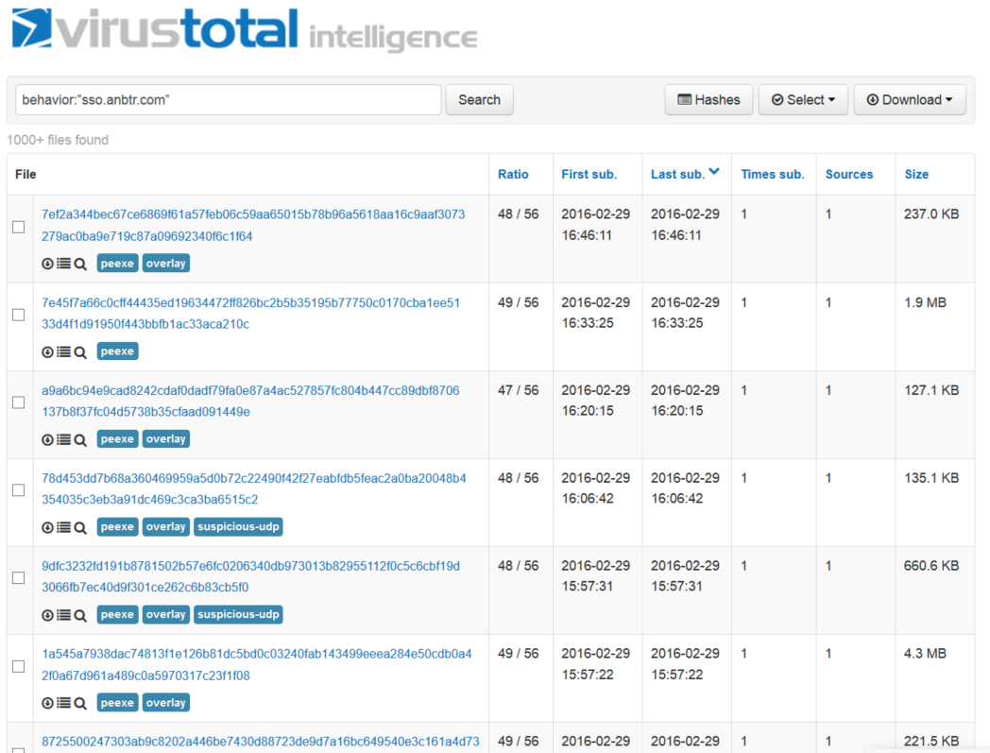
access files based on entries in VT’s dynamic behavior report
behavior:”sso.anbtr.com”
Notes:
To spelunk for files based on the dynamic behavior report VT produces:

Slide 26
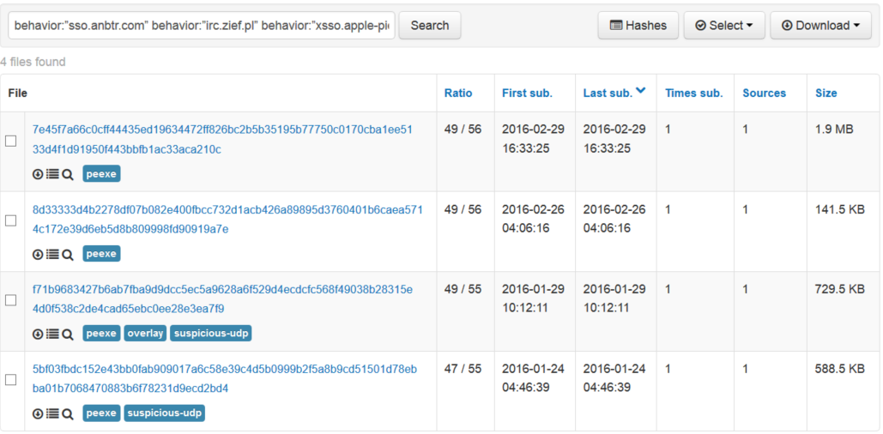
behavior:”sso.anbtr.com” and behavior:”irc.zief.pl” and behavior:”xsso.apple-pie.in”
Notes:
When you use multiple tags, “and” is implied. The above is EITest Threat Actor Teslacrypt DNS. You can use this information to find cyclic activity or waves of activity.

Slide 27
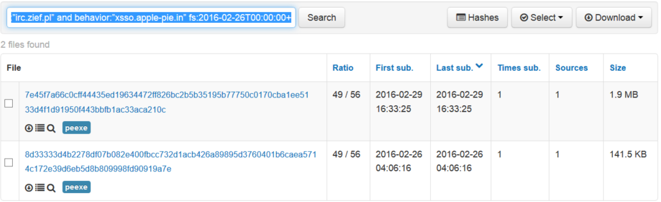
date first seen
behavior:”sso.anbtr.com” and behavior:”irc.zief.pl” and behavior:”xsso.apple-pie.in” and fs:2016-02-26T00:00:00+
Notes:
let’s bind to a time event

Slide 28
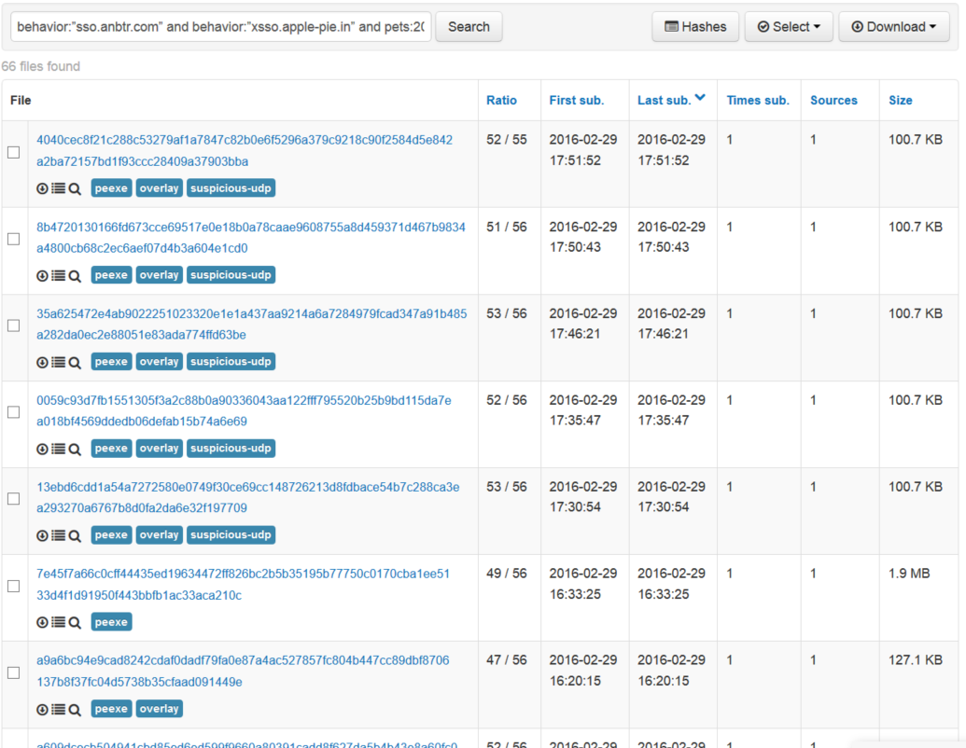
behavior:”sso.anbtr.com” behavior:”xsso.apple-pie.in” pets:2009-12-31T00:00:00- fs:2016-02-29T00:00:00+
Portable executable compilation timestamp
Notes:
looks for files that talk to those two domains, with a compilation timestamp earlier than the end of 2015 that was first seen on Feb 29, 2016 or later

Slide 29
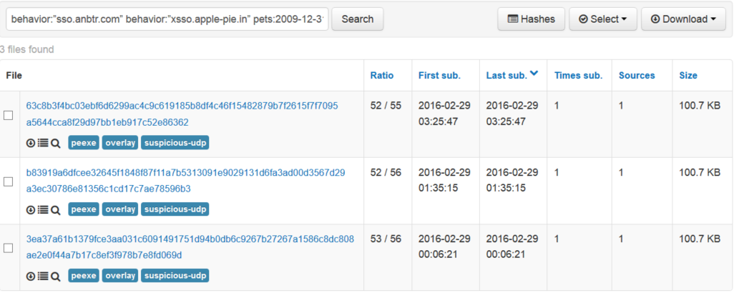
behavior:”sso.anbtr.com” behavior:”xsso.apple-pie.in” pets:2009-12-31T00:00:00- fs:2016-02-29T00:00:00+ behavior:”python.exe” behavior:”uxJLpe1m”
Mutex
Injected
Process
Notes:
Behavior is more than DNS, its also mutexes and injections, etc.

Slide 30
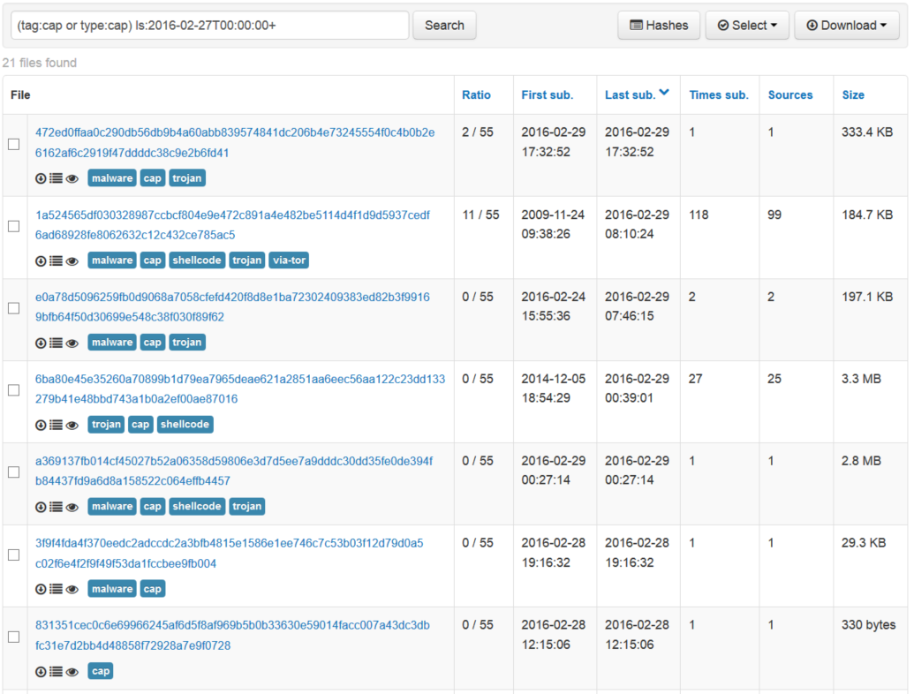
To gather up pcaps use tag:cap or type:cap (functionally the same), like:
(tag:cap or type:cap) ls:2016-02-27T00:00:00+
defines a file type
last seen date
Notes:
Search for pcap files. last seen date employed to keep the dataset in a reasonable range.

Slide 31
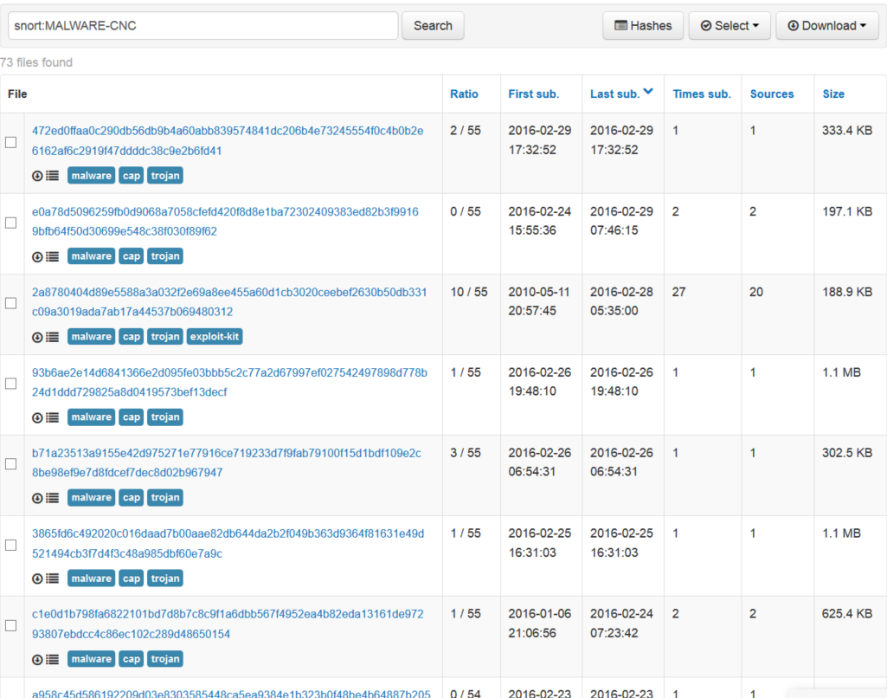
snort:MALWARE-CNC
snort IDS alert or classification string
Notes:
snort rule with partial description

Slide 32
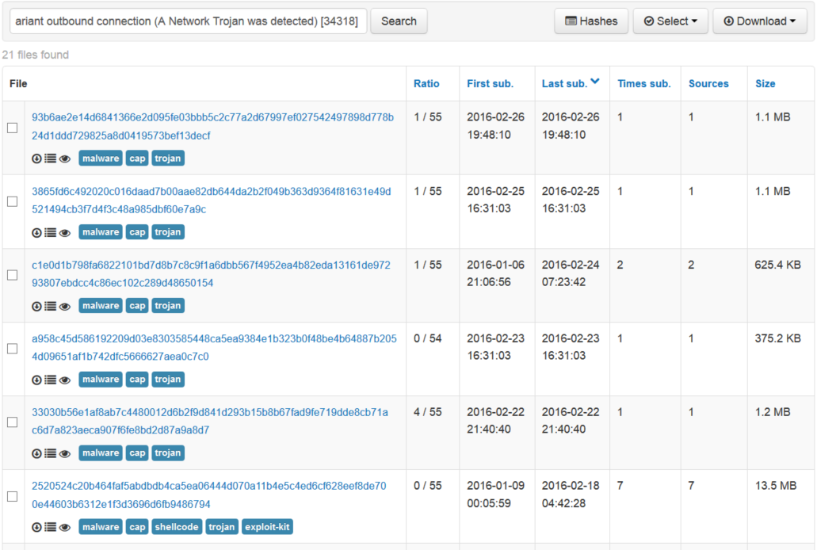
snort:MALWARE-CNC Win.Trojan.CryptoWall variant outbound connection (A Network Trojan was detected)
Notes:
snort rule with specific description.

Slide 33
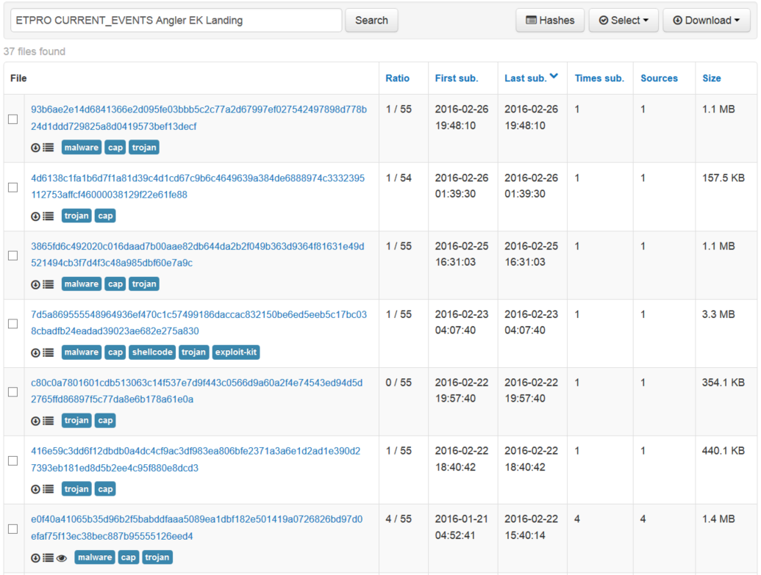
suricata with a general description:
ETPRO CURRENT_EVENTS Angler EK Landing
suricata IDS alert or classification string
Notes:
suricata with partial description.

Slide 34
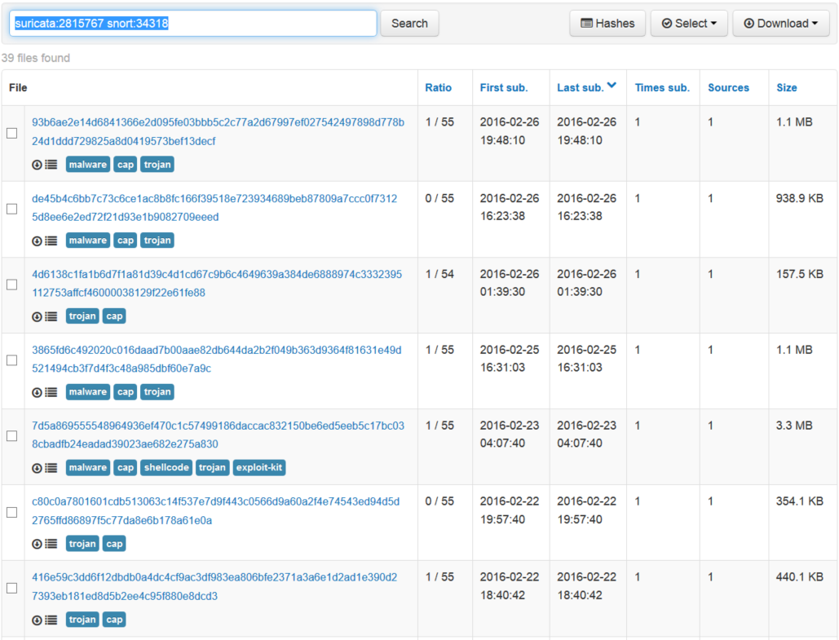
suricata and snort:
suricata:2815767 snort:34318
Can also search by specific IDs
Notes:
suricata and snort by ID number. If you employ this/these technologies, spelunk the data on VT cyclically to find indicators that may map against traffic you see in your own network.

Slide 35
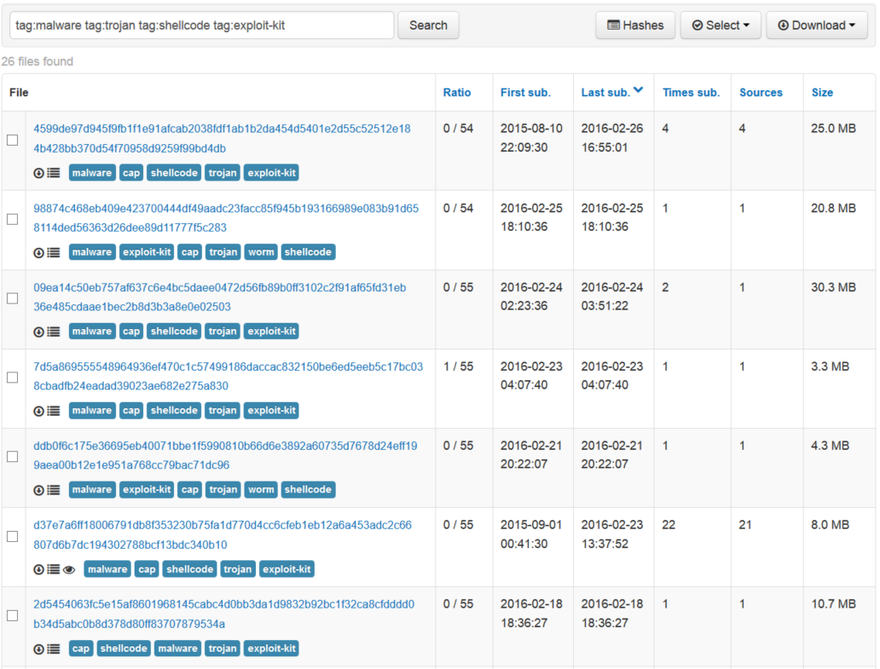
shellcode used for exploitation
tag:malware tag:trojan tag:shellcode tag:exploit-kit
general malware-related network flows
trojan-related network flows
exploit-kit related network flows
Notes:
full tag list here: https://www.virustotal.com/intelligence/help/ (need to have purchased the intelligence administration service (private key) to access).

Slide 36
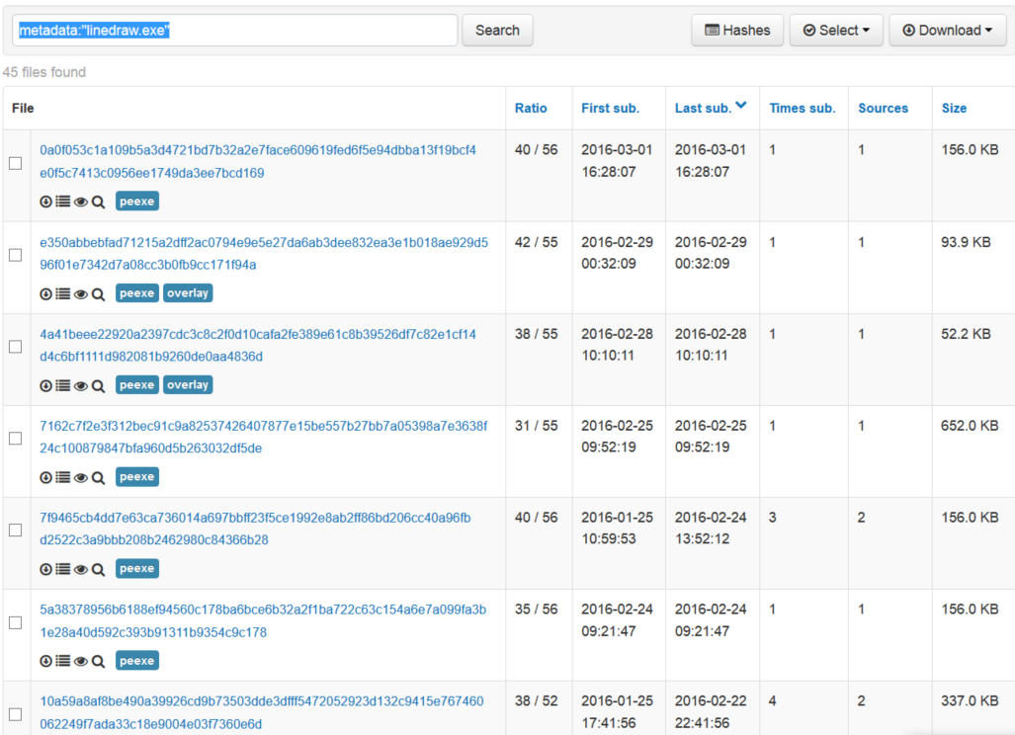
looks in metadata properties of files for matches
metadata:"linedraw.exe"
Notes:
talk about metadata tag but note that it doesn’t look in all files, but only *some* of the indexed files. It does, however, look in exif, pe metadata, office metadata, etc.
The above matches the Feb-Mar Dridex campaign

Slide 37
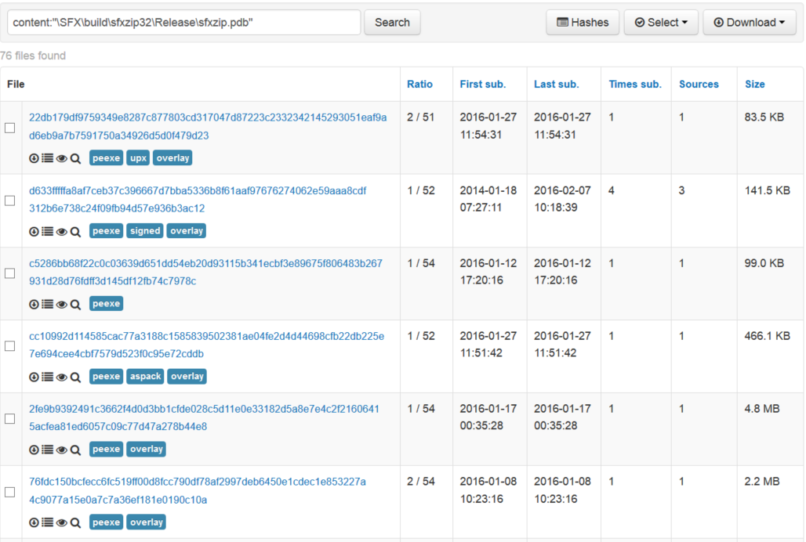
looks inside of files (hex or string) indexed in the last three weeks. Can be hit or miss on matching.
content:"\SFX\build\sfxzip32\Release\sfxzip.pdb"
Notes:
metadata versus content. Content only looks at the last 3 weeks of recent samples. Good for finding recent files of interested malware.

Slide 38
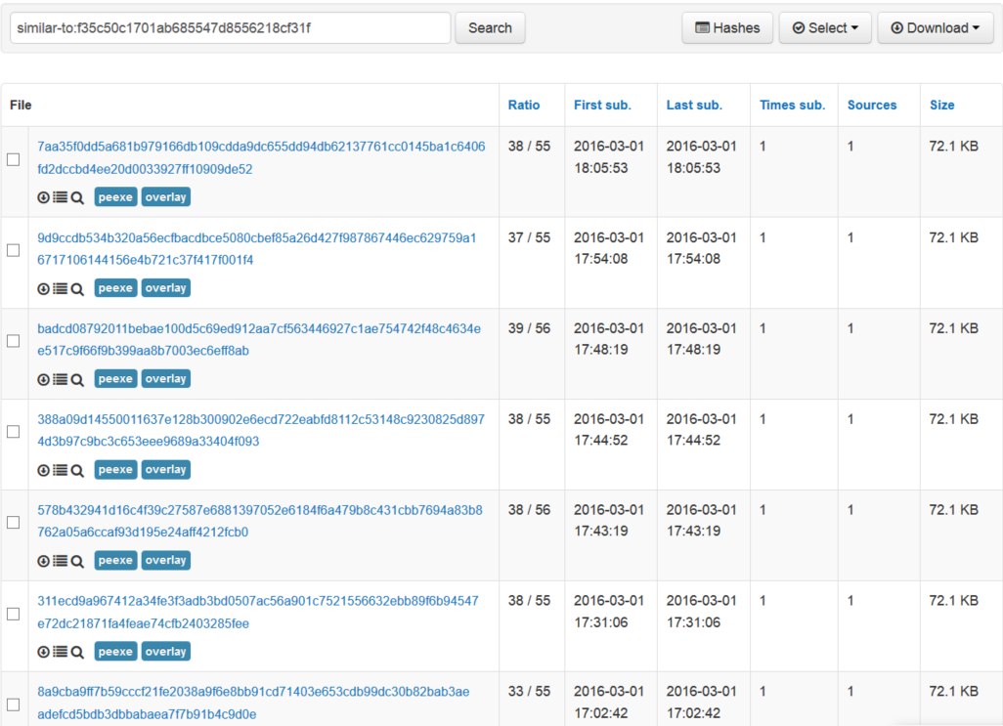
looks for files that are structurally similar to the target
similar-to:f35c50c1701ab685547d8556218cf31f

Slide 39
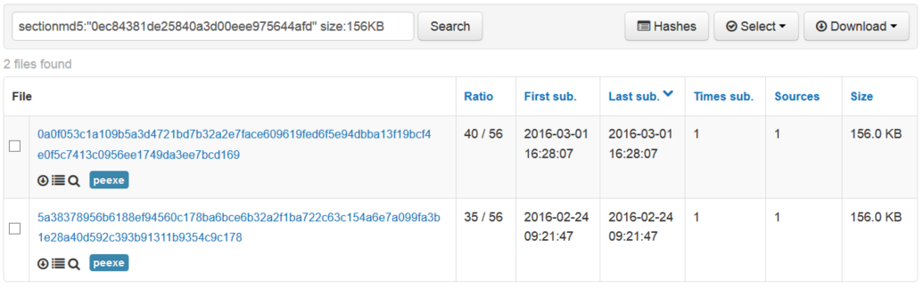
section hash
sectionmd5:"0ec84381de25840a3d00eee975644afd" size:156KB
size of the file (add “+” or “-” for greater or less than)
Notes:
can match on sectionmd5 (any section) and size (use + or - for greater or lesser amounts) 4k nulls or 0byte hash

Slide 40
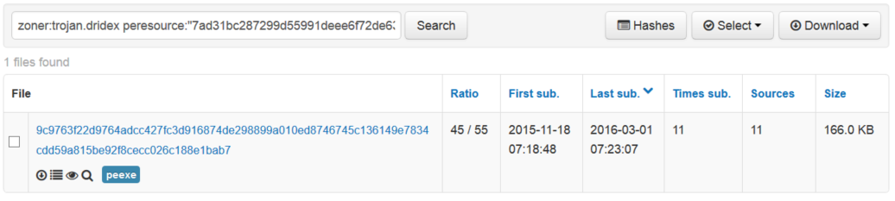
malware by name according to a given vendor
zoner:trojan.dridex peresource:"7ad31bc287299d55991deee6f72de63242c6a1438501fbad5bc8f6a773e7df6c"
hash value of a PE resource

Slide 41
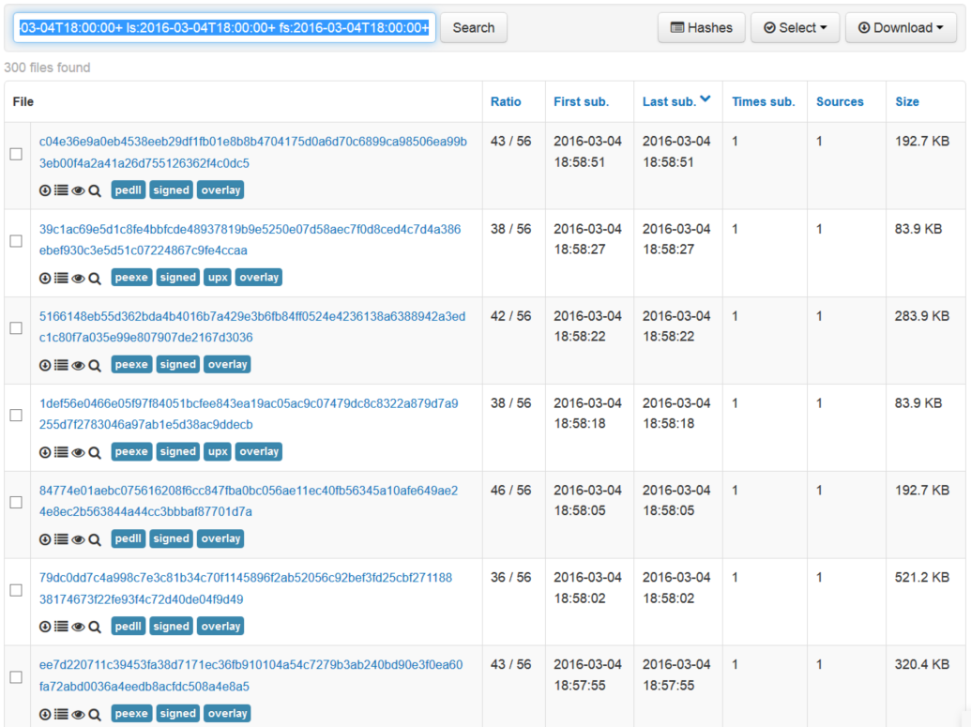
number of positive matches by av scanners
show files signed with a certificate
show files with an overlay
positives:35+ tag:signed tag:overlay la:2016-03-04T18:00:00+ ls:2016-03-04T18:00:00+ fs:2016-03-04T18:00:00+
date last seen
date last analyzed
Notes:
pDNS = domains == IP,

Slide 42
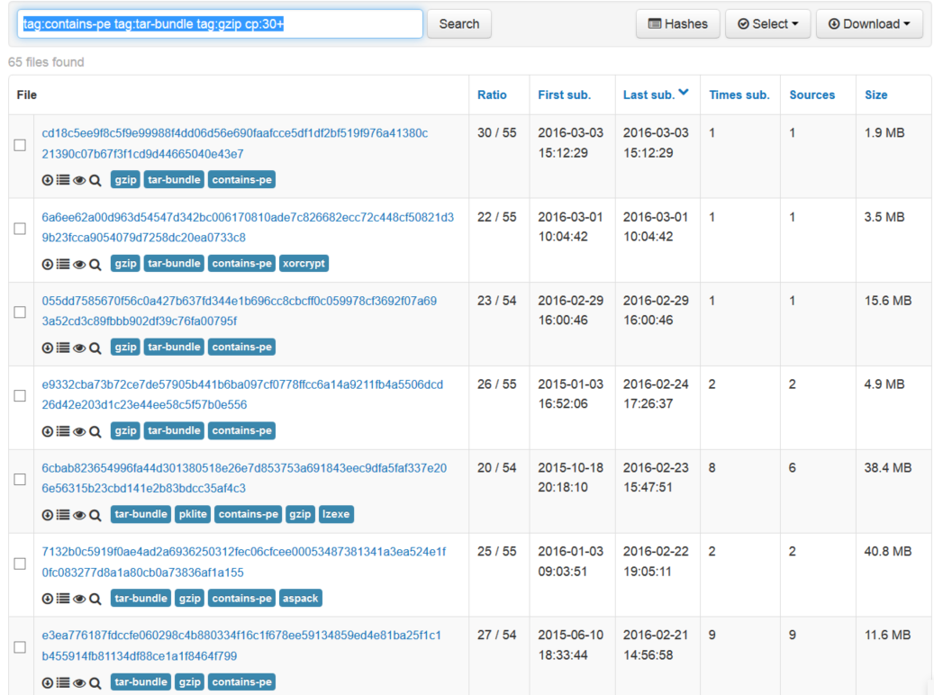
file bundle contains PE file
file type is gzip
returns files according to the max # of detections for children files in a bundle
compressed file that contains a tar bundle
tag:contains-pe tag:tar-bundle tag:gzip cp:30+
Notes:
pDNS = domains == IP,

Slide 43
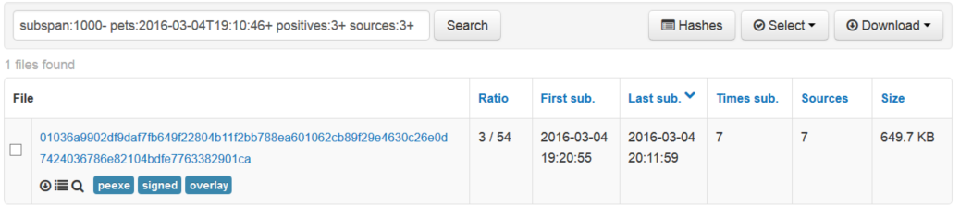
Difference in seconds between the first submission time and the compilation time
subspan:1000- pets:2016-03-04T19:10:46+ positives:3+ sources:3+
number of distinct sources submitting
Notes:
Useful to find executables that have been compiled and then were uploaded to VT (subspan). Sources is a way to refine it to a single source or multiple source. Can be combined with other tags to really refine the search to defied scenarios.

Slide 44
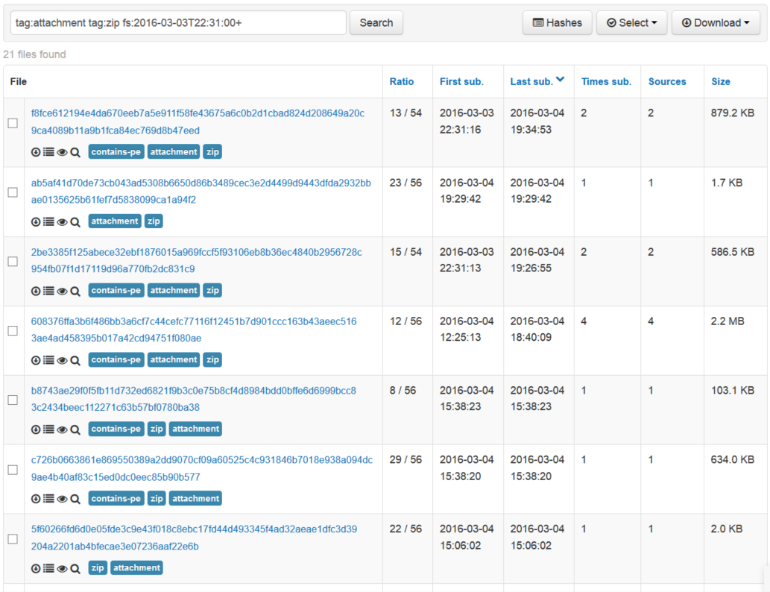
seen as an attachment to a spam/phishing email
identifies a zip bundle
tag:attachment tag:zip fs:2016-03-03T22:31:00+
Notes:
tag:attachment returns files seen as an attachment or file in spam emails. tag:zip is useful for defining zip bundles.

Slide 45
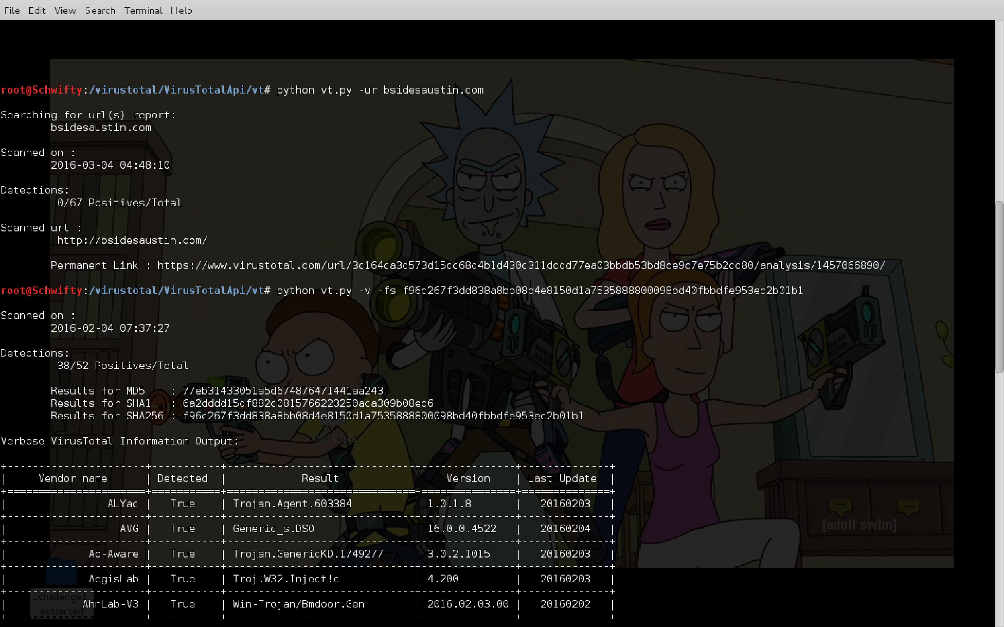
Public API use aka. Better living through scripting.
Notes:
VirusTotal's Public API lets you upload and scan files, submit and scan URLs, access finished scan reports and make automatic comments on URLs and samples without the need of using the HTML website interface. In other words, it allows you to build simple scripts to access the information generated by VirusTotal.
The chosen format for the API is HTTP POST requests with JSON object responses and it is limited to at most 4 requests of any nature in any given 1 minute time frame.
Before you start reinventing the wheel … there are a plethora of scripts readily available

Slide 46
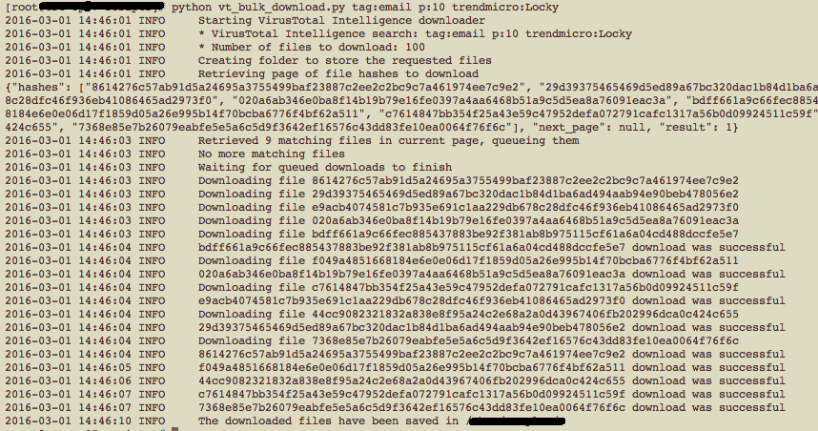
Python vt_bulkdownload.py tag:email p:10 trendmicro:Locky
Notes:
This example shows us gathering a batch of E-Mail files that are known by 10+ and labeled Locky by TrendMicro if it can be searched for it can be automated. Private key + vt intelligence = win

Slide 47
Questions?
Github link

